Slide 1
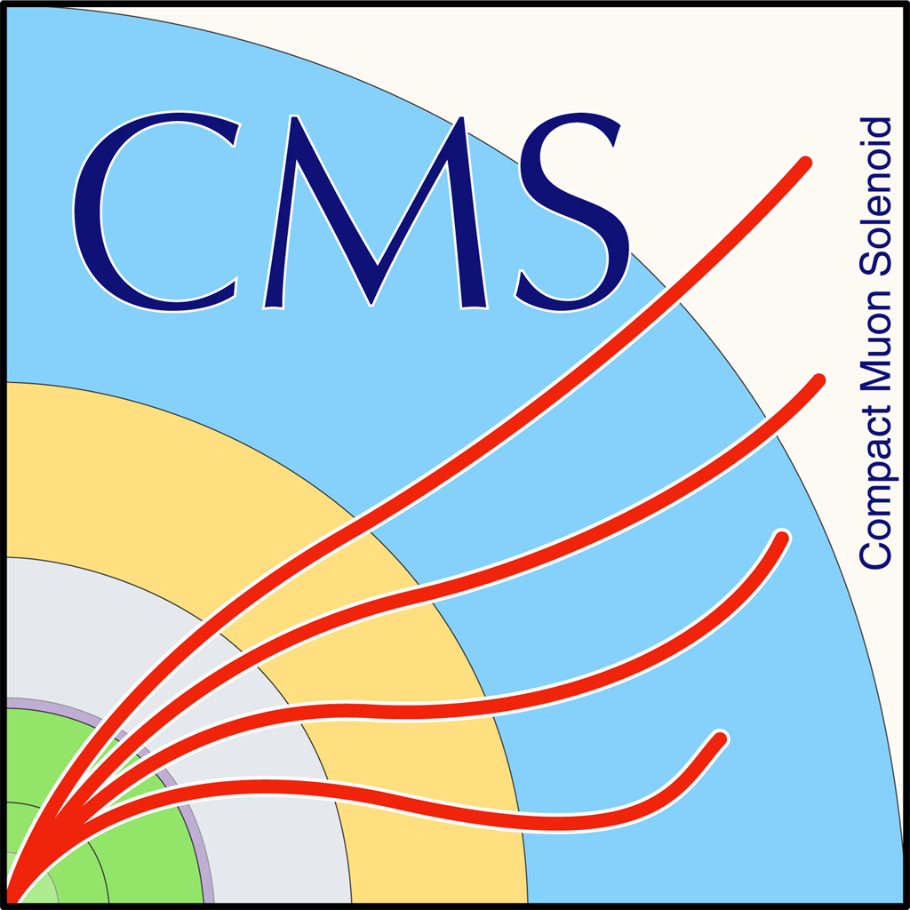

HEP Weekly Report
George Bakas

Slide 2
Weekly Report
Top Tagger:
New WP’s for 2017 and 2018
Production with 2018 Mtt 700-1000
Top Angular Distributions
Worked on the MC comparisons for the 2016, 2017 and 2018
Used for all the files the same WP until we reach a WP for every year
DCS:
ConfDbChecks in CMSfwInstallUtils
tool that allows checks between db and project.
Managed to show the user the reference of the problem
Testing
fwInstallationUtils
Further improvements to the tool
dpGet through Xmlrpc
Expose the dpSet functionality through cmsonline
Now the user can only use the functionality of dpGet through cmsonline
CMSfwClass
ArdEnvino
Box is ready
Because the Ethernet shield is not used, designed new lid (printing)
Left the box in the lab for live measurements with 1 BME 280 sensor (more to be added)

Slide 3
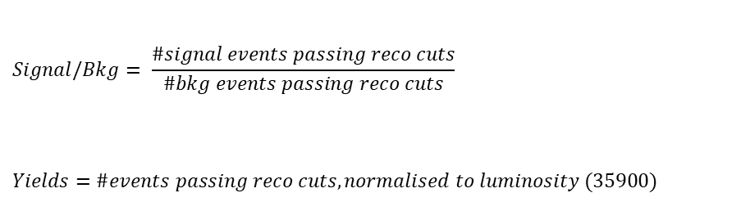
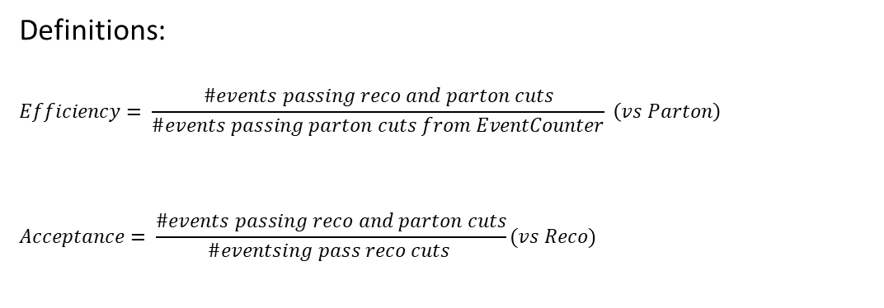
Overview
Efficiencies and Acceptance for mTT and jetPt variables
Selection:
Jet Matching
Parton cuts:
partonPt[0],[1] > 400
|partonEta[0],[1]| < 2.4
mTTbarParton > 1000
Reco cuts:
nJets > 1
nLeptons = 0
mJJ > 1000
jetPt[0],[1] > 400
|jetEta[0],[1]| < 2.4
bTagging (Medium WP deepCSV)
Tagger cut (top Tagger)
JetMassSoftDrop > 120 and < 220
Definitions:
$$Efficiency= \frac{\#events passing reco and parton cuts}{\#events passing parton cuts from EventCounter} \left(vs Parton\right)$$
$$Acceptance= \frac{\#events passing reco and parton cuts}{\#eventsing pass reco cuts }(vs Reco)$$
$$Signal/Bkg= \frac{\#signal events passing reco cuts}{\#bkg events passing reco cuts}$$
$$Yields=\#events passing reco cuts, normalised to luminosity (35900)$$

Slide 4
Purpose of this presentation
Purpose of this presentation is to find a Working Point for each MC (16, 17, 18) because the training is different for each year
Here we use only 1 file
2018 MC’s do not include a 700-1000 File so in order to check consistency of the efficiencies, acceptance etc we use only the 1000-Inf file
2016: We have already decided 0.2 as a WP
2017: The tested working points are 0.0, 0.05, 0.1, 0.15, 0.18
2018: The tested working points are 0.1, 0.15, 0.18, 0.2
For each of these WP’s we present the efficiency and acceptance and for the WP’s that seem promising (same efficiency for the pT variable) we show the Signal/Bkg and the expected yields

Slide 5
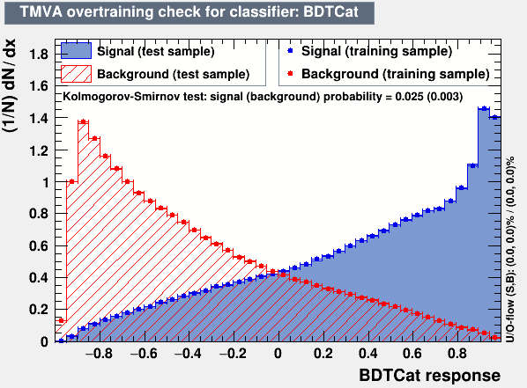
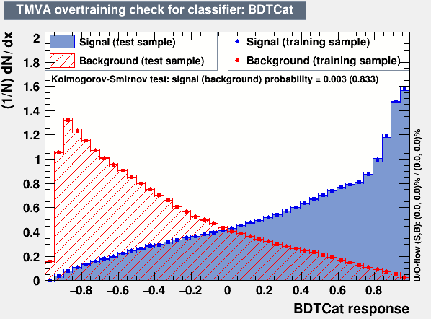
Training Outputs
2017
2018

Slide 6
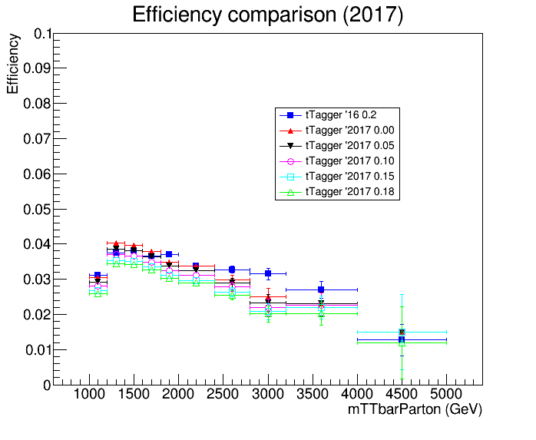
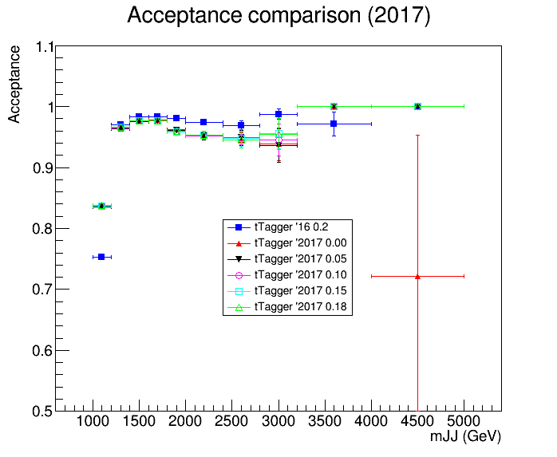
Acceptance and Efficiency 2016 vs 2017

Slide 7
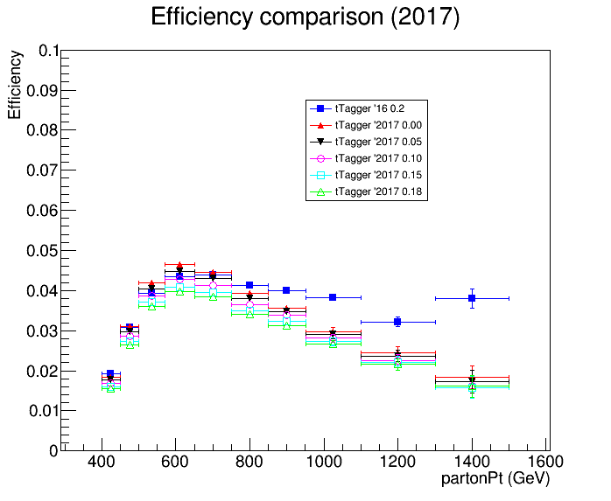
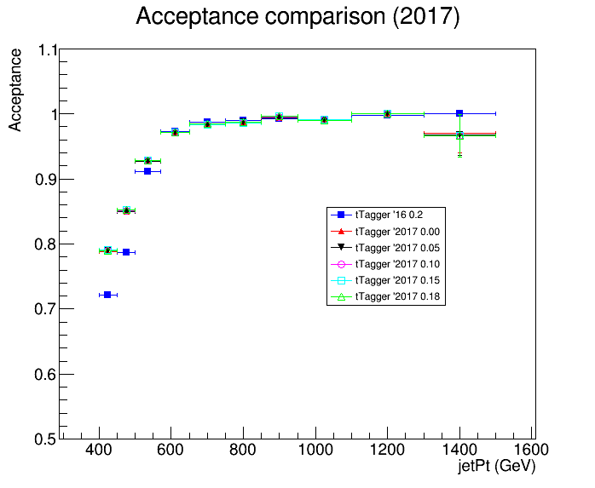
Acceptance and Efficiency 2016 vs 2017

Slide 8
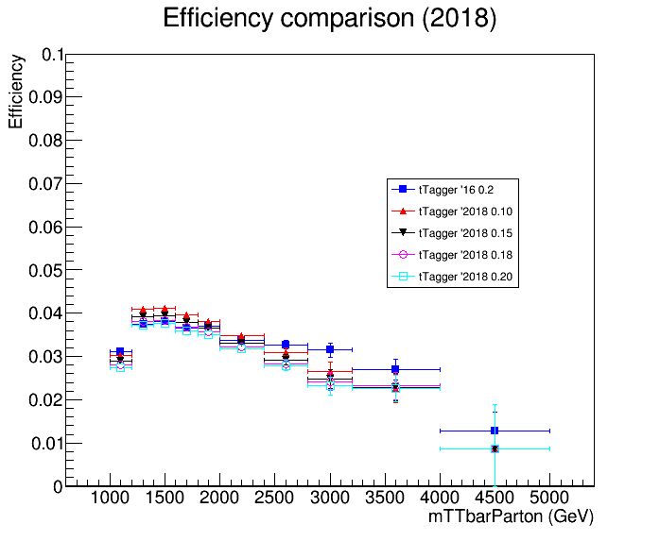
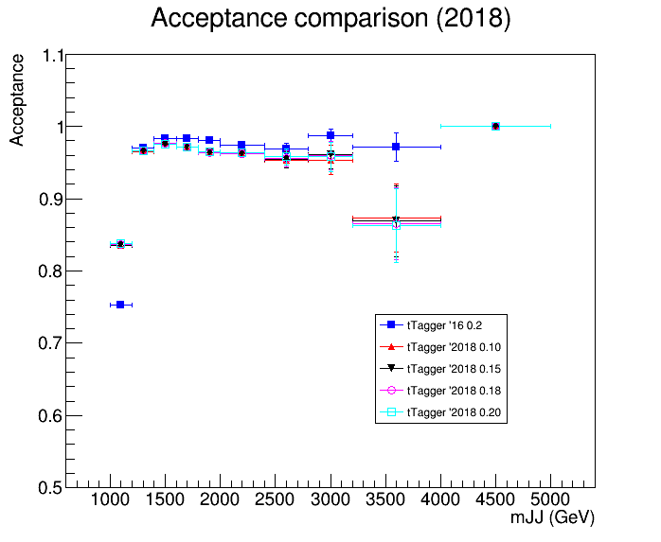
Acceptance and Efficiency 2016 vs 2018

Slide 9
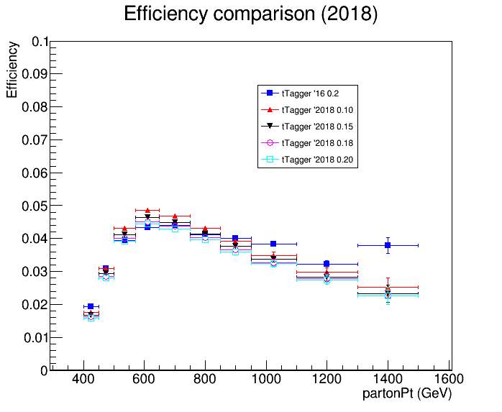
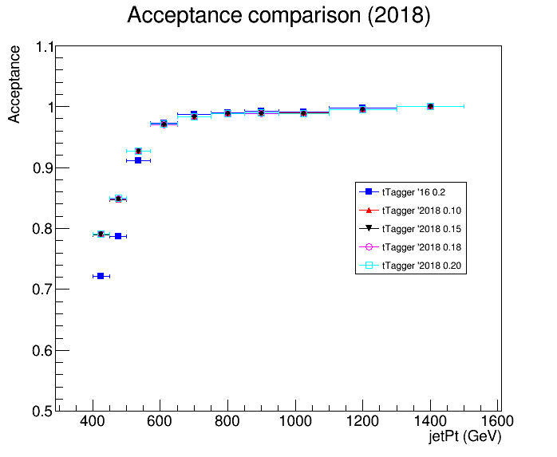
Acceptance and Efficiency 2016 vs 2018

Slide 10
Output
Most promising Working points that are compatible with the 2016 efficiency are the following:
2017: 0.0 and 0.1
2018: 0.15 and 0.18
For these WP’s I will investigate the Signal Over Bkg as well as the expected yields for measured variables

Slide 11
Top Spin Correlation
Files are ready (CMSSW 10_2X)
TT_noSC_Mtt-1000toInf_TuneCP5_13TeV-powheg-pythia8
TT_Mtt-1000toInf_TuneCP5_13TeV-powheg-pythia8
Chi2Test for various distributions
|Cos(χ₁)|, χ₁:angle between W’s in ZMF
|Cos(χ₂)|, χ₂:angle between top and W in ZMF
|Δφ| between W’s in parton level
What other distribution could have sensitivity to SC in the all hadronic channel?
If p_value < α (0.05) then we can assume that the hypothesis that the two histograms are identical is rejected
If p_value > α (0.05) then we can assume that the hypothesis that the two histograms are identical can be accepted
Chi2Test Results:
Chi2 = 143.020042, Prob = 2.53302e-16, NDF = 31, igood = 0
Chi2 = 38.513869, Prob = 0.166093, NDF = 31, igood = 0
Chi2 = 48.329603, Prob = 0.0135818, NDF = 29, igood = 0

Slide 12
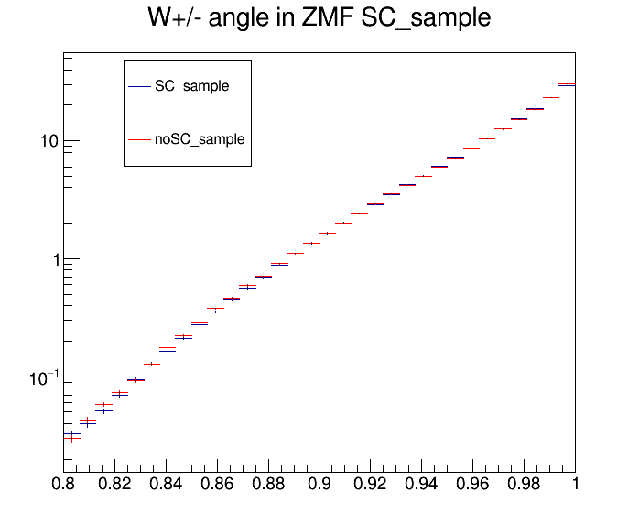
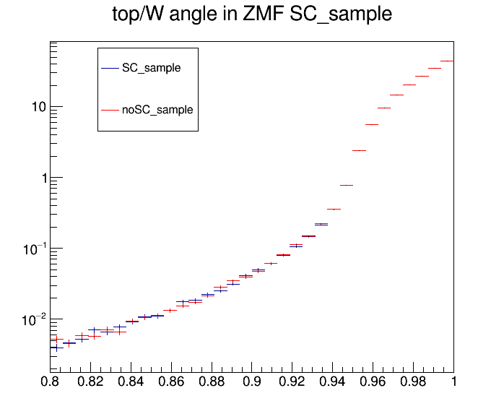
Top Spin Correlation
|cos(χ₁)|
|cos(χ₂)|

Slide 13
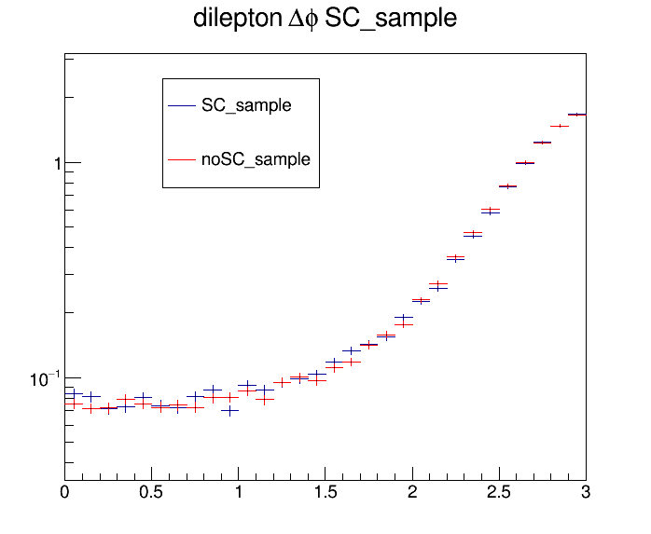
Top Spin Correlation
|Δφ|

